Slide 1
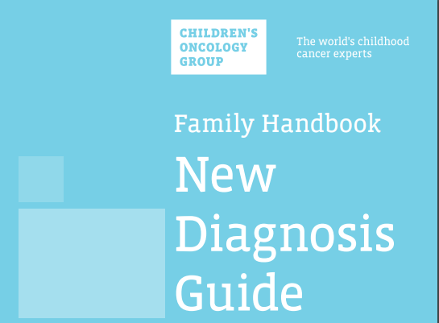
Caring for Your Child at Home
Notes:
Caring for Your Child at Home
We understand that this is an overwhelming and stressful time for you and your family.
Our goal is to help you focus on the most important information that you need right now.
We will continue to review important information with you throughout your child’s treatment.
Always feel free to stop me to ask questions, and also to ask questions of any member of your health care team

Slide 2
How to Use this Slide Set
Insert your hospital phone numbers, fever guidelines, and other information called out on the slides in Yellow. You can remove the yellow color of the text box once you have entered your hospital info.
Add additional hospital specific slides as needed.
COG slides cannot be edited, except to enter hospital specific information
You can print each slide and use as a flip chart. Print or show only the slides that are appropriate for the patient/family.
You can also view as a slideshow on a desktop, laptop, or tablet and use navigation links. Each block on the Table of Contents slide is a hyperlink to the corresponding content. If presenting on a computer/tablet, use the “Table of Contents” button to link back to the Table of Contents page so you can navigate to the appropriate content for the patient/family you are teaching (e.g. Choose the Port to review port information and skip the slides on the PICC and External CVL since the patient does not have those types of lines).
Notes:
Delete this slide before printing or viewing with a patient and family.

Slide 3
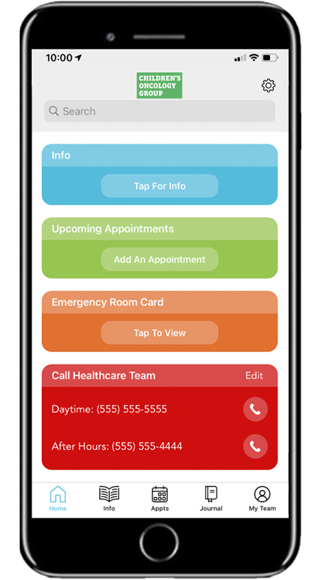
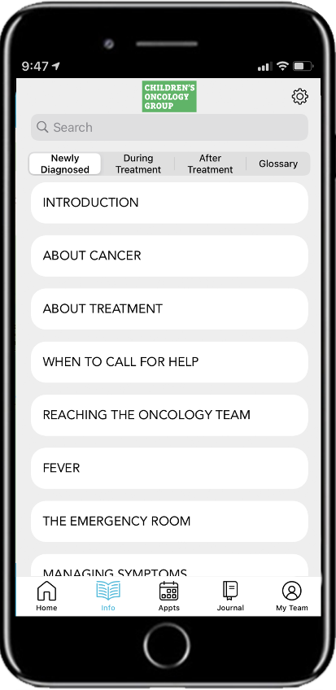
Resources: COG KidsCare App
Download the COG KidsCare App from the Apple Store (for iPhones) or from Google Play (for Android phones)
Notes:
THE CHILDREN’S ONCOLOGY GROUP KIDSCARE APP
The COG KidsCare App contains all of the information in the New Diagnosis Guide and Family Handbook.
You can download the App from the Apple App Store (for iPhones) or from Google Play (for Android phones).

Slide 4
What is
Cancer?
Who to Call
For Help
Fatigue
How is Cancer Treated?
When to Call
For Help
Preventing
Infections
PICC
Line
Visiting the Emergency Room
Precautions During Treatment
External
CVL
Managing
Symptoms
Giving
Medicines
Port
Brain Tumor Precautions
Wound
Care
Notes:
Here is a list of the topics in this program. You can click on any topic to go to that slide. If you wish to return to this slide, click on the Table of Contents button located in the upper right corner of each slide.

Slide 5
Table of Contents
About Cancer and its Treatment

Slide 6
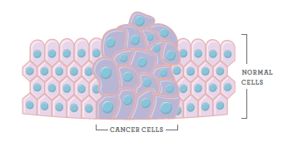
What is cancer?
Table of Contents
Cancer in children falls into one of 3 groups:
Leukemias are cancers of the of blood-forming cells
Lymphomas are cancers of the immune system
Solid tumors are cancers of the brain, bones, muscles, organs, or other tissues in the body
Notes:
What is cancer?
Cancer is one name for a group of diseases. Each type of cancer has its own name, treatment, and prognosis (chance of responding to treatment).
Cancer in children can generally be divided into three groups:
Leukemias are cancers of the blood-forming cells
Lymphomas are cancers of the immune system
Solid tumors are cancers of the brain, bones, muscles, organs, and other tissues in the body

Slide 7
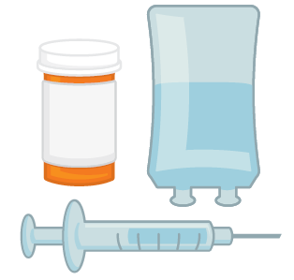
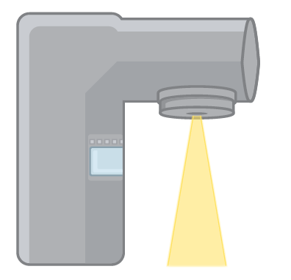
How is cancer treated?
Table of Contents
Each type of childhood cancer is treated differently.
Your child’s treatment may include one or a combination of the following:
Chemotherapy
Immunotherapy
Surgery
Radiation
PICC
Ext. CVL
Port
Notes:
How is cancer treated?
Each type of childhood cancer will be treated differently, depending on what doctors have found to be the best treatment for that type of cancer. Your child may receive one type of treatment, or a combination of different types of treatment at different times during their therapy.
Note: Focus on the treatment option that is appropriate for the patient/family you are teaching.
Chemotherapy is a type of medicine that treats cancer by stopping cells from growing, or by destroying cells.
Chemotherapy can be given in a number of ways including:
by mouth
into a vein
as an injection (shot)
into the spinal fluid
Talk to your health care team about the ways your child’s chemotherapy will be given.
Immunotherapy uses the immune system (infection fighting cells) or medicines made in the laboratory from immune cells to fight cancer.
Immunotherapy can be given:
By mouth
Into a vein
Talk to your health care team about the ways your child’s chemotherapy will be given.
Surgery: Different types of surgery are used to treat cancer.
Sometimes, taking out the tumor may be the only treatment needed.
Usually chemotherapy, immunotherapy, or radiation is also used to kill any cancer cells still in the body
Radiation therapy delivers high energy x-rays that damage and destroy rapidly growing cells, such as cancer cells.
Click the button for the type of line your patient has to be taken directly to that section.

Slide 8
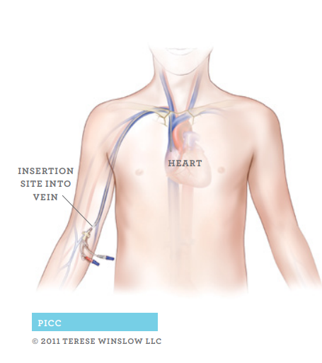
Central Venous Line (CVL): PICC
Table of Contents
Notes:
A central venous line: provides a safe way to give medicines, including chemotherapy, through a vein.
If your child has a PICC (peripherally inserted central catheter), your nurse will teach you how to care for this line at home, including how to cover the line for bathing
Never use scissors near the line or dressing
If you see a break or leak in the line, clamp the line above the break right away. Call your health care team and take your child to the hospital or clinic to have the line fixed.

Slide 9
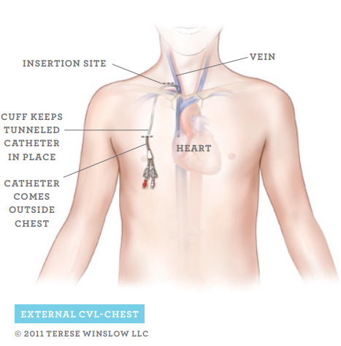
Central Venous Line (CVL): External
Table of Contents
Notes:
A central venous line: provides a safe way to give medicines, including chemotherapy, through a vein.
If your child has an external CVL, your nurse will teach you how to care for this line at home, including how to cover the line for bathing
Never use scissors near the line or dressing
If you see a break or leak in the line, clamp the line above the break right away. Call your health care team and take your child to the hospital or clinic to have the line fixed.

Slide 10
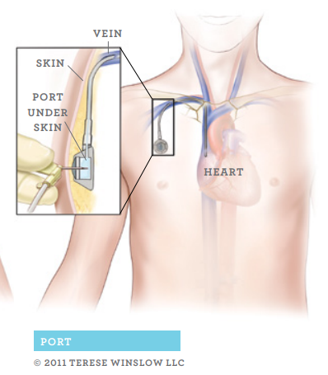
Central Venous Line: Port
Table of Contents
Notes:
A central venous line: provides a safe way to give medicines, including chemotherapy, through a vein.
A port is a catheter under the skin. A special needle is inserted into the port.
If your child has a port, you may be asked to apply a numbing cream on the skin over the port before your child comes to the clinic or Emergency Room. The cream can help make putting the needle in the port easier for your child. Check with your child’s nurse to see if this is something your child will need.
When your child is not in the hospital or clinic, the needle does not stay in the port. Your child will not have any lines/tubes outside of the skin.

Slide 11
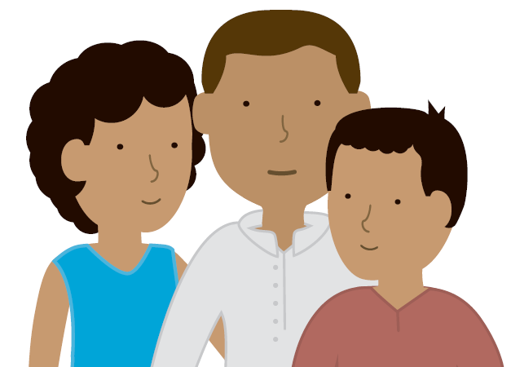
Talking with Your Child About Cancer
Table of Contents
Understanding of cancer and treatment depends on child’s age and other factors
Important for child to know diagnosis and plan
Health care team members can help
Talk with your health care team about your needs
Notes:
Talking with Your Child About Cancer
Children of different ages understand and react differently to cancer and its treatment
Many things may affect how your child copes with cancer, including his/her age, personality, coping style, support system, and treatment plan
Often parents have a hard time telling their child about cancer
From years of experience, we know that not telling your child about his/her diagnosis and treatment plan can be harmful
Children can quickly sense when something is wrong. They need to know they can trust their parents to always tell them the truth.
There are members of your health care team who are available to help you and your child cope
Talk with your health care team about your needs so that you can get the right support

Slide 12
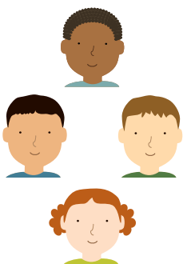
Clinical Trials
Table of Contents
Most children with cancer are treated on clinical trials
Children’s Oncology Group conducts clinical trials
Goal is to improve treatment and support for children with cancer
Your child’s doctor and health care team will explain if a trial is available for your child
You may choose whether or not to participate
Notes:
Clinical Trials
Most children with cancer are treated on clinical trials
Clinical trials are research studies done to help the health care team understand about diseases such as cancer and how best to treat them
Progress in treatment for childhood cancer has been made possible through clinical trials
The Children’s Oncology Group is the largest pediatric clinical trials group in the world; COG has treated more children with cancer than any other organization
Doctors, nurses, and other experts around the world are working to continually improve treatments for childhood cancer
Your doctor and health care team will explain if there are clinical trials available for your child
You may always choose whether or not your child will be part of a clinical trial
If you choose to be part of a clinical trial, you will need to give your permission first. This is called informed consent.
You can talk to your health care team to learn more.

Slide 13
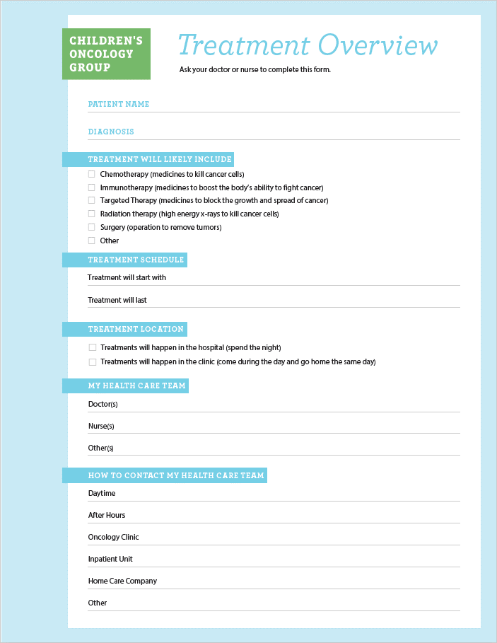
Treatment Overview
Table of Contents
Ask your health care team to help you complete your child’s Treatment Overview
Keep this with you
Show it when needed, such as when visiting the Emergency Room
Notes:
This Treatment Overview page is included in the beginning of the New Diagnosis Guide
You can use it to record your child’s diagnosis and important treatment information
You can also record what phone numbers to call when you need help
Ask your health care team to help you to complete the Treatment Overview page before you go home
Keep the Treatment Overview page with you and show it when needed, such as when you visit the Emergency Room

Slide 14
Table of Contents
Who to Call for Help

Slide 15
How to Reach Your Health Care Team
Table of Contents
Daytime: _______________________________
After Hours: ____________________________
Other: _________________________________
Notes:
How to Reach Your Health Care Team
It is important to know who to call if your child develops an emergency or urgent health care problem.
Keep these important telephone numbers with you at all times.
You can write these phone numbers on your Treatment Overview page.
If your child will be cared for by someone else, be sure that they also have these important phone numbers, and that they understand when to call for help.
Note: Enter your hospital specific information here. You can remove the yellow color of the text box once you have entered your hospital info.

Slide 16
Table of Contents
When to Call for Help

Slide 17
Emergency Help
Table of Contents
Call
9-1-1
Call 911 immediately if your child:
Is not breathing or has severe difficulty breathing
Has skin and/or lips that look blue
Is having a seizure
Does not wake up after you have tried to wake them
Notes:
Emergency Help
Sometimes children with cancer will have symptoms that are warning signs of a serious condition. Your health care team considers these symptoms a sign of an emergency. In an emergency, you need to take action right away.
Call 911 immediately if your child:
is not breathing or has severe difficulty breathing
has skin and/or lips that look blue
is having a seizure – and you have not been told how to manage this at home
does not wake up after you have tried to wake them – this is known as “loss of consciousness”
Note: This slide applies to hospitals in the US and Canada. Please insert appropriate emergency response slide for hospital in other countries.

Slide 18
Table of Contents
When to Call for Immediate Help
Insert your hospital/clinic
phone numbers here:
Fever:
Insert your hospital/clinic
fever guidelines here
Call
right away!
Chills (shivering)
Do not wait until the clinic opens
Notes:
When to Call for Immediate Help
A fever may be a sign of a serious infection.
Children who receive cancer treatment are at high risk for getting serious infections.
If your child has a fever and does not get medical care right away, your child could get very sick and this could be life-threatening. ·
Call your health care team immediately if your child has a fever. Do not wait for the clinic to open.
Do NOT give your child aspirin (salicylate), acetaminophen (Tylenol®), or ibuprofen (Motrin®, Advil®, and Pediaprofen™) unless you are told to do so by your health care team.
Sometimes an infection can occur without fever. Any time your child has chills or you are concerned that they do not look well, even if there is no fever, call your health care team immediately. Do not wait for the clinic to open.
If your child becomes ill or has a fever, there is a chance your child will need to be admitted to the hospital for antibiotics and care.
Note: Enter your hospital/clinic phone numbers. You can remove the yellow color of the text box once you have entered your hospital info.
Note: Enter your hospital fever guidelines. You can remove the yellow color of the text box once you have entered your hospital info.

Slide 19
Taking Your Child’s Temperature
Table of Contents
Have working thermometer
Learn how to take child’s temperature
Check child’s temperature if they feel warm or do not look or feel well
Do not take a rectal temperature
Notes:
Taking your child’s temperature:
Make sure that you have a thermometer at home that works, and that you know how to use it.
Take the temperature if your child feels warm to touch or does not look or feel well.
Take the temperature as you have been taught by your health care team.
Do not take a rectal temperature as this could cause bleeding or infection.

Slide 20
Table of Contents
When to Call for Immediate Help
Insert your hospital/clinic
phone numbers here:
Trouble with breathing
Bleeding that does not stop within 5-10 minutes
Call
right away!
Do not wait until the clinic opens
Notes:
Call your health care team right away if your child has:
Trouble with breathing
Bleeding that does not stop within 5 to 10 minutes

Slide 21
Table of Contents
When to Call for Immediate Help
Insert your hospital/clinic
phone numbers here:
Change in behavior
Sudden change in vision
Severe or repeated headache
Call
right away!
Do not wait until the clinic opens
Notes:
Call your health care team right away if your child has:
Change in behavior, such as becoming very sleepy or irritable, or not making sense
A sudden change in vision
A severe headache, or repeated headaches

Slide 22
Table of Contents
When to Call for Immediate Help
Insert your hospital/clinic
phone numbers here:
New weakness
Uncontrolled pain
A break or leak in the central line
Call
right away!
Do not wait until the clinic opens
Notes:
Call your health care team right away if your child has:
New weakness of the face, arm or leg
Pain that is not controlled with prescribed medicine
A break or leak in the central line

Slide 23
Table of Contents
When to Call for Immediate Help
Insert your hospital/clinic
phone numbers here:
Repeated vomiting or diarrhea
Not able to drink fluids
Exposure to chicken pox or shingles
Call
right away!
Do not wait until the clinic opens
Notes:
Call your health care team right away if your child has:
Repeated vomiting or diarrhea
Being unable to drink fluids
Being exposed to chickenpox or shingles
For any of these problems, remember, call your health care team right away. Do not wait until the clinic opens!

Slide 24
Table of Contents
When to Call for Help
Insert your hospital/clinic
phone numbers here:
If you are unsure or uneasy about anything, it is always better to call than not call!
Call
Call
Call
Notes:
If you are unsure or uneasy about anything, it is always better to call than not call!

Slide 25
Table of Contents
Visiting the Emergency Room (ER)
Tell the ER staff about your child, including:
Type of cancer
Last treatment
Fever requires immediate care,
often including antibiotics
No waiting in areas with other people who may be sick
No rectal temperature or medications
Notes:
Visiting the Emergency Room (ER)
If your child has a fever or other emergency, your health care team may tell you to go to the Emergency Room.
When you arrive in the Emergency Room, tell them:
Your child’s type of cancer
Date of your child’s most recent cancer treatment
That your child must be seen right away for a fever and given antibiotics promptly
That your child cannot wait in an area with other people who may be sick
That your child cannot have a rectal temperature, enema, or suppository
Ask your health care team for a letter that explains your child’s diagnosis and possible needs in the Emergency Room. Bring this letter with you any time you take your child to any Emergency Room.
Bring your Treatment Overview page with you when you visit the Emergency Room.

Slide 26
Table of Contents
Managing Symptoms
Notes:
Managing Symptoms:
Our goal is to keep your child safe and feeling as well as possible during treatment. By understanding the side effects of treatment, you will know how to support your child and when to call the health care team for help. It is always OK to ask for help if your child is not feeling well or is uncomfortable, whether your child is in the hospital or at home.
In the next slides, we are going to talk about some of the side effects of treatment and how to manage symptoms.

Slide 27
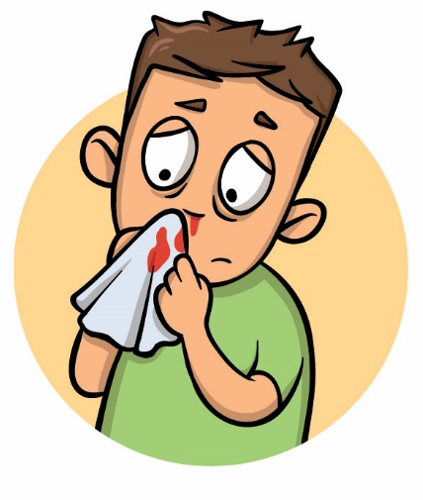
Table of Contents
Bleeding and Feeling Very Tired
Call if your child has any of these symptoms:
Very tired
Pale
Dizzy
Bad headache
Bruising
Small red dots on skin
Bleeding from the nose, gums, or around the central venous line
Call immediately for bleeding that does not stop within 5-10 minutes
Notes:
Bleeding and Feeling Very Tired
Cancer treatment can lower your child’s blood counts. This can cause bleeding or make your child feel very tired.
Call your health care team if your child:
is very tired
pale
complains of headache or dizziness
bruising more easily than usual
has small red dots on the skin
has bleeding from the nose, gums, or around the central venous line
Call your health care team immediately if your child has bleeding that does not stop within 5 to 10 minutes.

Slide 28
Table of Contents
To Prevent Bleeding:
Avoid rough play and contact sports
Use a soft toothbrush
Avoid giving aspirin or ibuprofen
Notes:
To prevent bleeding:
avoid rough play and contact sports
use a soft toothbrush
avoid giving your child aspirin or ibuprofen during times when the blood counts are low

Slide 29
Table of Contents
Pain
Call if your child has:
New or increasing pain
Pain that is not getting better with the pain medicines you have been given to use at home
Notes:
Pain in children with cancer can be from many causes. Cancer cells in the body can cause bone or tissue pain. Some side effects of cancer treatment, such as mouth or skin sores, can be painful. Recovering from some surgery can also be painful.
Call your health care team if your child has:
new or increasing pain
pain that is not getting better with the pain medicines you have been given to use at home

Slide 30
Table of Contents
Nausea, Vomiting, Diarrhea
Use medicines given by your health care team
Give sips of cool, clear liquids
Offer small bites of foods that are easy to digest, such as:
Crackers
Rice
Notes:
Nausea, Vomiting, Diarrhea
Cancer therapy can cause nausea, vomiting and diarrhea (frequent, watery stools).
You may be sent home with medicines to give at home to help with nausea and vomiting or diarrhea. Follow the instructions carefully.
If your child has nausea or vomiting or diarrhea, you can also offer sips of cool, clear liquids or small bites of foods that are easy to digest, such as crackers or rice.

Slide 31
Table of Contents
Dehydration
Call immediately if your child has:
Dry mouth or lips
No tears when crying
Urinating less than normal
Dark urine
Repeated vomiting or diarrhea
Is not able to drink fluids
Notes:
Dehydration:
Vomiting and diarrhea can place your child at risk for dehydration (not enough liquid in the body).
Call your health care team immediately if your child has signs of dehydration, which may include:
dry mouth or lips
no tears when crying
urinating less than normal
dark urine
has repeated vomiting or diarrhea
is not able to drink fluids

Slide 32
Table of Contents
Constipation
Call if your child has:
A change in their regular bowel movement pattern (not as often, not as much)
Pain when having a bowel movement
Hard stool even after giving medicine for constipation
Notes:
Constipation is when a child has hard stools (bowel movements) that happen less often than usual.
Chemotherapy (such as vincristine) and other medicines (such as pain medicines) can cause constipation.
Follow the instructions for any medicines you are given to help with constipation at home.
Call your health care team if your child has:
a change in their regular bowel movement pattern (not as often, not as much)
pain when having a bowel movement
hard stool even after giving medicine for constipation

Slide 33
Table of Contents
Hair Loss
Hair on all parts of the body may be affected
Cutting the hair as short as possible may help
Hair usually grows back when:
Treatment gets milder, or
After treatment finishes
Notes:
Hair Loss:
Some kinds of cancer therapy may cause hair loss or thinning of the hair.
Hair loss differs for every child, but may begin as early as 7 to 10 days after the treatment has started. Hair on other parts of the body may also be affected.
Some children and parents prefer to cut the hair as short as possible when the hair starts to fall out.
Hair will usually grow back when the cancer treatments become milder, or when treatment is finished.

Slide 34
Table of Contents
Fatigue

Slide 35
Fatigue
Table of Contents
Many things can cause fatigue
Cancer treatment
Low blood counts
Poor nutrition
Fever
Pain
Not getting enough sleep
Poor quality of sleep
Medications
Worry or depression
Trying to do too much
Lack of physical activity
Notes:
Many children with cancer have fatigue during and following treatment. Children may describe fatigue as being tired or feeling weak. Children have also described fatigue as not having enough energy to do the things they enjoy, or even talk and be with other people. Many things can cause fatigue, such as:
Cancer treatment (surgery, chemotherapy, or radiation)
Low blood counts
Poor nutrition
Fever
Pain
Not getting enough sleep
Poor quality of sleep
Medications
Worry or depression
Trying to do too much
Lack of physical activity

Slide 36
Managing Fatigue
Table of Contents
You can do many things to help your child
Encourage physical activity every day
If appetite poor, offer healthy foods every 2-3 hours while awake
Try to make each snack as nutritious as possible
Avoid caffeine
Have a regular bedtime routine
Notes:
Tell your health care provider if your child has fatigue. You can do many things to help your child
When possible, encourage physical activity every day.
A physical therapist can help with an exercise program to increase your child’s strength and endurance.
If your child’s appetite is poor, offer healthy foods every two to three hours while awake
Try to make each snack as nutritious as possible. Talk to your dietician for ideas.
Avoid caffeine: This includes coffee, tea, soda and energy drinks
Have a regular bedtime routine and ensure your child gets plenty of sleep each night
Recommended sleep hours in healthy children:
3-5 years: 10-13 hours/night
6-13 years: 9-12 hours/night
14-17 years: 8-10 hours/night
Children experiencing fatigue may need more sleep than these recommendations or may need to nap during the day
If your child is having pain that interferes with sleep, talk to your health care team

Slide 37
Managing Fatigue
Table of Contents
Physical activity
Simple movements that kids already do
Walking
Play
Dance
Can help improve mood
Decrease fatigue
Connect with family & friends
Some activities may be limited or restricted based on your child’s cancer or treatment
Notes:
It is important for your child to stay physically active while receiving cancer treatment. Being physically active can be simple movements that kids already do which includes play and dance.
Being active not only helps physical recovery, but can help improve mood, lessen fatigue, and is a great way to connect with friends, siblings and family. Some activities may be limited or restricted depending on the type of cancer, treatment, or any medical devices that your child may have (such as a port or G-tube).
Talk to your health care team about what physical activity is best for your child. Walking is generally acceptable, with the goal of increasing steps and decreasing time spent sitting or lying down. If your child has pain or difficulty with movement, please talk to your health care provider about a referral to physical therapy.

Slide 38
Table of Contents
Preventing Infection
Notes:
Preventing Infection:
Whether at school, home, or in your community, your child will be exposed to germs.
We all have germs on our skin and in our mouth and intestines (gut).
Germs can also be found in the environment and in people with infections.
Children being treated for cancer cannot fight germs as well as healthy children.
It is very important to prevent infection.

Slide 39
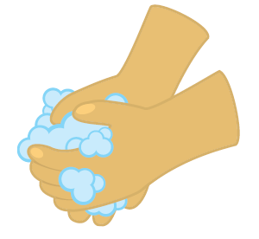
Table of Contents
Handwashing
Handwashing helps prevent infection
Wash hands often with soap and water or use a hand sanitizer:
After using the toilet
Before caring for your child
Before preparing your child’s medicines
Before preparing your child’s food
Notes:
Handwashing:
The most important way to prevent infection is to keep your hands clean and to help your child do the same.
To prevent the spread of germs from one person to another, encourage your child, family members, and visitors to:
Wash hands often with soap and water and/or use a hand sanitizer:
After using the toilet
Before caring for your child
Before preparing your child’s medicines
Before preparing your child’s food

Slide 40
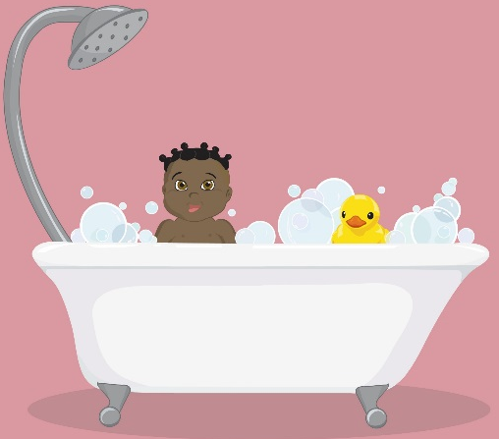
Table of Contents
Hygiene
Remind your child:
Not to share cups, water bottles, or eating utensils with other people
Not to share a toothbrush with anyone
To bathe or shower regularly, as instructed by your health care team
Do not share
cups, utensils
Bathe or shower regularly
Notes:
Hygiene:
It is also important to remind your child:
Not to share cups, water bottles, or eating utensils with other people
Not to share a toothbrush with anyone
Bathe or shower regularly, as instructed by your health care team

Slide 41
Table of Contents
Screen Visitors for Illness
Check with friends and visitors before they arrive
People can visit your child except if they have:
Fever
Runny nose
Cough
Diarrhea
Rash
Other symptoms of illness
Recently exposed to infection
Notes:
Screen Visitors and Friends for Illness:
We encourage your child to continue to have visitors, including other children
Be sure to:
Ask ahead of time if the visitor or friend is sick or has been exposed to an infection
Anyone who has a fever, runny nose, cough, diarrhea, or rash should not visit your child

Slide 42
Table of Contents
Caring for Animals
Your child should not clean:
Animal or bird cages
Aquariums
Cat litter boxes or animal waste
If you live on a farm:
Talk with your health care team about safety tips for your child
Do not handle
animal waste
Notes:
Caring for Animals:
If your family has a pet, your child should not clean animal cages (such as a bird cage or turtle aquarium), empty cat litter boxes, or deal with animal waste.
Animal waste may carry germs that can spread to your child.
If you live on a farm, talk with your health care team about any additional safety measures that may be needed when working with animals.

Slide 43
Table of Contents
Precautions During Treatment
Notes:
Preventing Infection:
Whether at school, home, or in your community, your child will be exposed to germs.
We all have germs on our skin and in our mouth and intestines (gut).
Germs can also be found in the environment and in people with infections.
Children being treated for cancer cannot fight germs as well as healthy children.
It is very important to prevent infection.

Slide 44
Table of Contents
Precautions During Treatment
Brush teeth
regularly
Call if exposed to
chicken pox
(varicella)
Talk to your
health care team
about vaccines
Notes:
Dental Care:
Keep your child’s teeth, mouth, and gums clean.
Brush teeth after each meal and before bed with a soft toothbrush and toothpaste.
Check with your health care team before taking your child to the dentist.
Vaccinations:
Some vaccines should not be given while your child is receiving treatment.
Flu shots are usually recommended for your child and all family members.
Talk to your health care team before your child receives any vaccines.
Varicella Exposure:
If your child has been in contact with anyone who has the chickenpox or shingles, call your health care team immediately.
It is possible your child will need to get a medicine to protect against chickenpox. For this medicine to work, your child must get it as soon as possible after contact.

Slide 45
Table of Contents
Precautions During Treatment
Take these precautions for 48 hours
after the last dose of chemo:
Wear gloves when
handling waste
Close the lid,
flush two times
Wash soiled
clothes separately
Notes:
Chemo Safety:
Chemotherapy leaves the body through urine, stool, and vomit.
Because of this, while your child is receiving chemotherapy and for 48 hours after the last dose, it is important to take the following precautions:
Wear disposable nitrile gloves (available at most drug stores and pharmacies) when handling your child’s body waste (urine, stool, vomit) or items soiled with waste.
Always wash your hands after taking off the gloves.
Close the lid and flush twice after each time your child uses the toilet.
Wash clothes or bed linens that have been soiled with body waste separately from other laundry using hot, soapy water. Then wash them again with your regular laundry.
If soiled clothes or bed linens cannot be washed right away, keep them in a sealed plastic bag.
Dirty items that are not soiled with body waste can be touched and washed as usual.
If your child is in diapers, wear disposable nitrile gloves when changing diapers and seal the soiled diapers in a plastic bag before disposal.
When possible, women who are pregnant or breastfeeding should avoid touching a child’s body waste during and for 48 hours after the child receives chemotherapy. If it is necessary for a pregnant woman to handle soiled items during this time, they should wear disposable nitrile gloves.

Slide 46
Table of Contents
Giving Medicines
Notes:
Giving Medicines
It is important to understand the reason for each of your child’s medicines, and how to give each of them correctly.
The main types of medicines are for:
Treatment of cancer (some children will take these medicines at home)
Prevention of complications (such as infection)
Management of symptoms (such as pain and nausea)

Slide 47
Table of Contents
Giving Medicines
For each medicine, you should know:
Medicine name
What it is for
When to give it
How to give it
Notes:
Giving Medicines
Before you go home, you will receive a list of your child’s medicines. Be sure that you know:
The name of each medicine
What each medicine is for
How much medicine to give
When to give the medicine
How to give the medicine
Your child’s nurse can show you how to give each of the medicines to your child. Talk with the nurse to plan a time to practice giving the medicines to your child before you go home.
It is also best to pick up your child’s medicines from the pharmacy before you go home so that you can review them with the health care team. If you are not able to pick up the medicines before you go home, be sure you know where to get the medicine, and what to do if the pharmacy is unable to get any of your child’s medicines for you.
If your child has trouble taking medicines or cannot swallow pills, tell your child’s nurse or doctor. They can help you find the best way to give the medicine to your child. Your nurse or child life specialist may also be able to help your child learn and practice how to swallow pills.

Slide 48
Table of Contents
After you go home:
End
Bring medicines and medicine list with you to the clinic, hospital, or ER
Tell us when you need a refill
Keep medicines locked in a safe place
Notes:
After you go home:
Bring your child’s medicines and medicine list with you each time you come to the clinic, hospital, or Emergency Room.
Let your doctor or nurse know right away when your child’s supply of any medicine is running low.
Keep your child’s medicines locked in a safe place, out of reach of children and pets.

Slide 49
Table of Contents
Brain Tumor and Shunt Precautions

Slide 50
Table of Contents
Brain Tumor and Shunt Precautions
End
Call 911 immediately if your child has a:
Seizure (and you have NOT been taught what to do at home)
Insert your hospital/clinic
phone numbers here:
Call immediately if your child has:
Severe or repeated headaches
Repeated vomiting
Extreme sleepiness
Irritability
Confusion
Swelling or redness along the shunt tract
Call
right away!
Notes:
Brain Tumor and Shunt Precautions
Call 911 immediately if your child has:
A seizure and you have not been taught what to do at home
Call your health care team immediately if your child has:
Severe or repeated headaches
Repeated vomiting
Extreme sleepiness
Irritability
Confusion
Swelling or redness along the shunt tract

Slide 51
Table of Contents
Wound Care

Slide 52
Table of Contents
Wound Care
End
Your nurse can show you how to care for the wound and change the bandage if needed.
Keep the area clean and dry.
Protect the wound until fully healed.
Notes:
Wound Care:
If your child has had surgery:
Your child’s nurse can show you how to care for the wound and to change the bandage if needed.
Generally, it is important to
Keep the area clean and dry, and to
Protect the wound from stress (such as rough activities) until it is fully healed.

Slide 53
Table of Contents
Review

Slide 54
Review
Let’s review who to call:
Daytime: _______________________________
After Hours: ____________________________
Other: _________________________________

Slide 55
Review
Let’s review fever:
Insert your hospital/clinic
fever guidelines here

Slide 56
Questions
???

Slide 57
We are here to help!
For more information, please see the
COG Family Handbook
https://www.childrensoncologygroup.org/
index.php/cog-family-handbook

Slide 58
DISCLAIMER AND NOTICE OF COPYRIGHT
The information and content provided in this Children’s Oncology Group New Diagnosis Guide: Caring for Your Child at Home slide set is made available for informational purposes only for children and their families affected by cancer. While the Children’s Oncology Group strives to provide accurate and up-to-date information, the information may be out of date or incomplete in certain respects. Please do not rely on this information and seek the care of a qualified medical professional if you have questions regarding a specific medical condition, disease, diagnosis, or symptoms. The information and content presented herein is not intended to replace the independent clinical judgment, medical advice, screening, health counseling, or other intervention performed by your (or your child’s) health care provider. Please contact “911” or your emergency services if this is a health emergency. No endorsement regarding the safety, appropriateness, or effectiveness of any specific tests, products, or procedures is made herein.
The Children’s Oncology Group New Diagnosis Guide: Caring for Your Child at Home slide set is proprietary to the Children’s Oncology Group (©2019-2024)

Slide 59
Credits
Thank you to the COG Nurses
that contributed to this slide set:
Jeneane Sullivan, Editor
Elizabeth Duffy, Contributor
Teresa Herriage, Contributor
Lori Ranney, Contributor
Nancy Tena, Contributor
Stephanie Gil, Contributor
Marie-Hélène Colpron, Reviewer - French Translation
Lanipua Yeh-Nayre, Reviewer - Spanish Translation

Slide 60
Credits
Vector Illustrations
Property of Eric Uchalik
Used with permission
(Slides 6, 7, 11, 12, 33, 38, 41)
Medical Illustrations
©2011 by Terese Winslow, LLC
Used with permission
(Slides 8,9, 10)

Slide 61
Thank you!
Funding for the French and Spanish translations of this slide set were made possible through the generosity of the Andrew McDonough B+ Foundation.

